Slide 1
Pi-value for Gene Significance Evaluation
Incorporating and keeping a balance of both statistical significance and biological significance of differential expression.
1. Statistically speaking, genes showing systematic difference between two conditions are considered DE, usually measured by P-value.
2. Biologically speaking, DE means the difference in gene expression is sufficiently large.
Pi-value algorithm: fundamental formula: pi-value= FC *-(logP), where FC=log fold change, P is p value from t test.

Slide 2
Pi-value for Gene Significance Evaluation
Pi-value can address two issues regarding gene significance evaluation
1. The ‘small fold change, small variance’ (SFSV) issue. When a gene's variance is small, a slight expression level change may result in significant P-value and conclusion of statistical significance.
2. The ‘large fold change, large variance’ (LFLV) issue. In such a situation, a large expression change may be accompanied by a non-significant P-value
To see the effectiveness, pi-value = log(1/P^FC). If DE more than 2 fold change, FC is bigger, P^FC is smaller(0<P<1), 1/P^FC is larger. Thus, pi-value is larger. So original p value get enhanced in this way
If DE less than 2 fold. FC smaller, P^FC is larger(0<P<1), 1/P^FC is smaller. Thus, pi-value is smaller. Original p value get punished in this way.

Slide 3
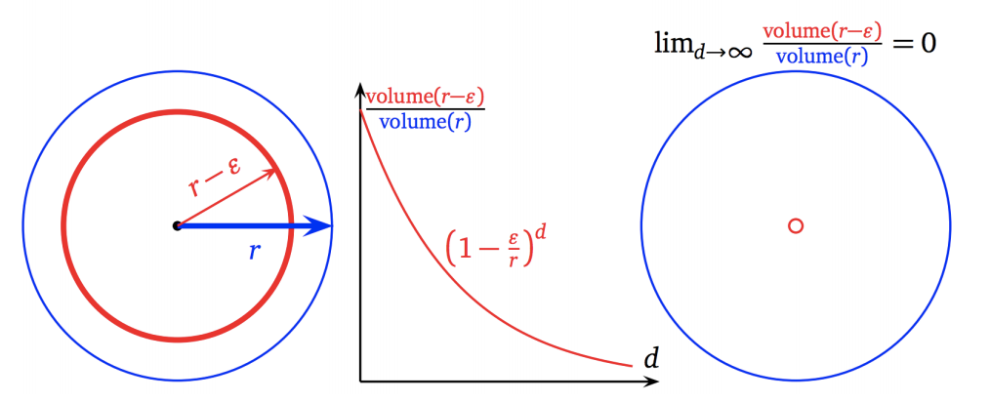
Clustering Analysis.
Purpose: After regrouping the data according to treatments and conditions, we want to use clustering analysis to see if there’s significant separations(aka differences) amongst groups.
Challenge: Curse of Dimensionality: Small sample(less than 100 patients) size but very high dimensionality(200 + significant genes).
In high dimension hyperspace, as features(dimensions) increase, even the most similar points tend to deviate from each other, thus resulting in high entropy within clusters or too many clusters.
Example:

Slide 4
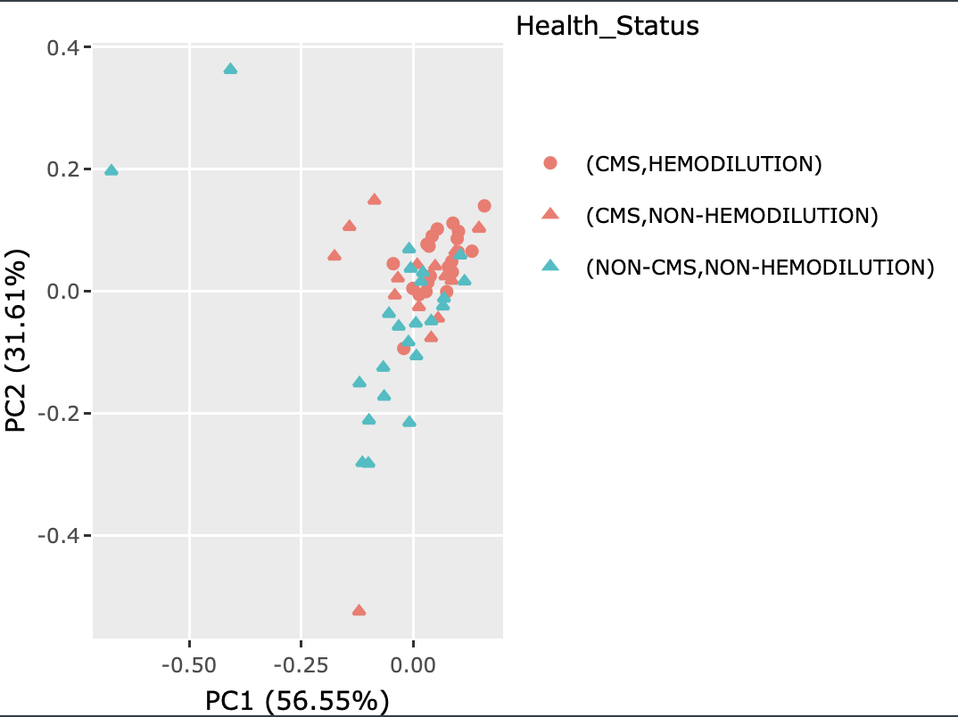
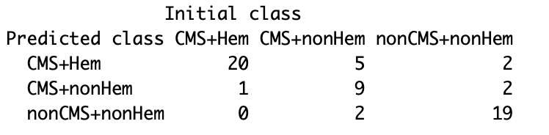
Clustering Analysis
Using PCA and Discriminant Analysis.
PCA is a mainly a dimensionality reduction method but can also serve as a clustering visualization method. It finds the directions in hyperspace that capture most of information(variance).
Discriminant Analysis uses Expectation-Maximization Algorithm to build model that maximizes the conditional probability P(K|X), i.e Given the DE data, we categorize the sample(CMS, nonCMS etc.) as the one with highest probability.

